Slide 1


I&M Apparels

Slide 2

I & M is a online shopping app that offers convenient and seamless shopping to all the users. I & M provides the secure and fast delivery
I&M Apparels

Slide 3

So Why Use our App?

Slide 4

I&M FEATURES

Slide 5

Reliability
Safe Transactions
Easy Navigation
Speed

Slide 6
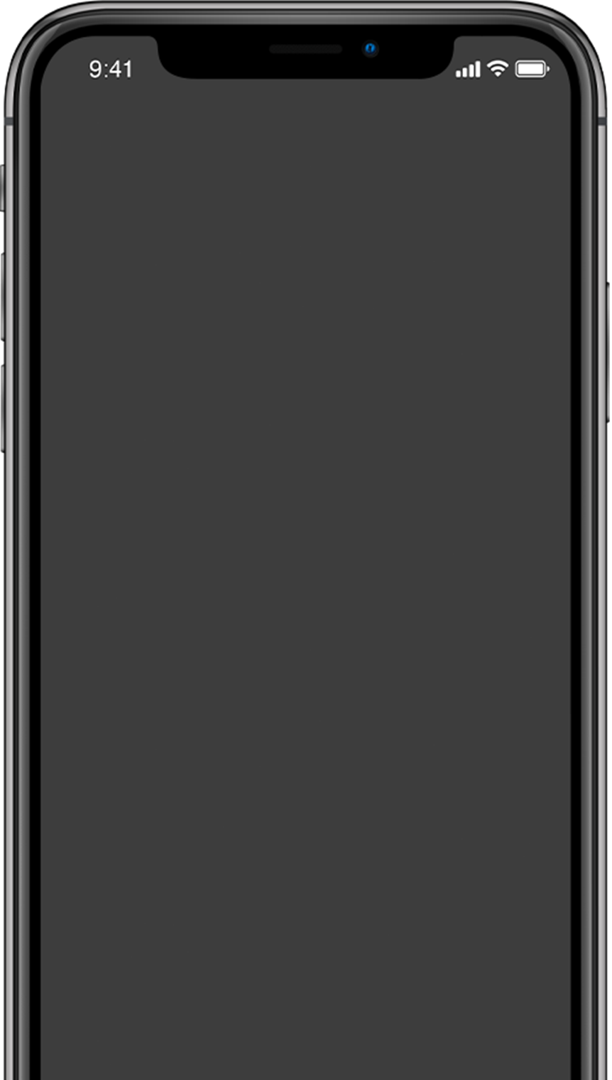
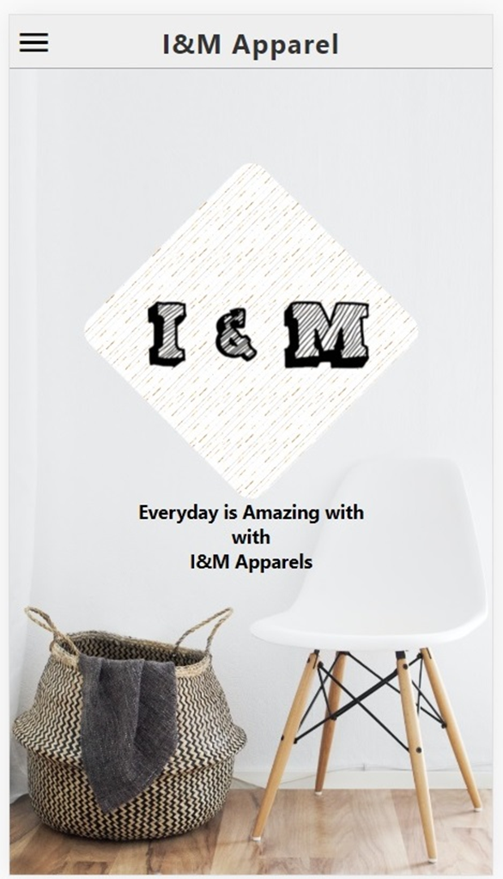
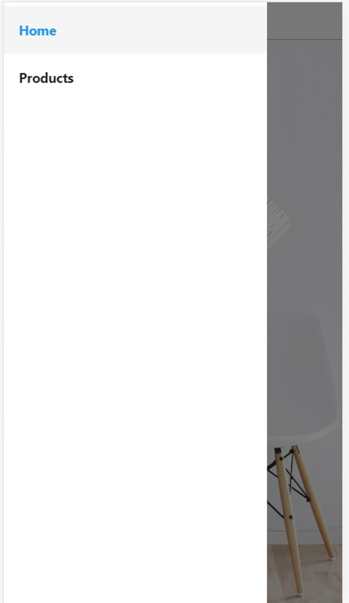
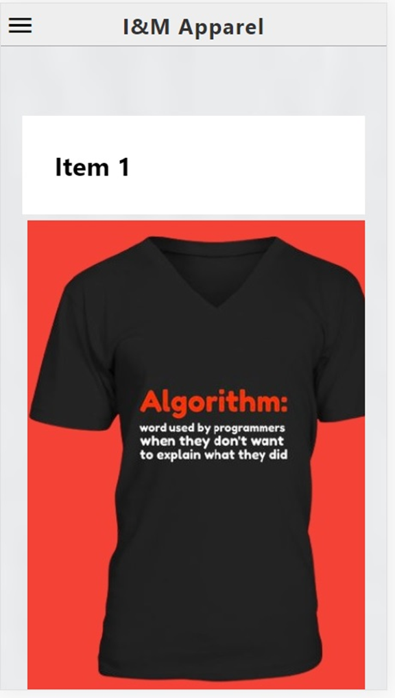

Slide 7


I&M Programmers:
ISAIAH R.AGAPITO
MICHAELA ANN P. ARCAYA

